Slide 1

Solving Student Enrollment and Graduation Rates with Data
Lewis Manyasa
2 October 2025
Software Engineering
1

Slide 2

SDG 4: Quality Education
Quality education
SDG Overview
SDG 4 aims to ensure inclusive and equitable quality education and promote lifelong learning opportunities for all. Achieving this goal involves addressing barriers such as gender inequality, poverty, and lack of access to educational resources, ensuring that no one is left behind in the pursuit of education.
Problem Definition
Student enrollment and graduation rates are critical indicators of access to quality education.
Disparities in enrollment and graduation rates exist across regions, genders, and socioeconomic backgrounds.
Socioeconomic status, gender, and regional access to educational resources often influence these rates.
This project will analyze trends and identify areas where intervention is needed to improve accessibility and retention in education.
2

Slide 3
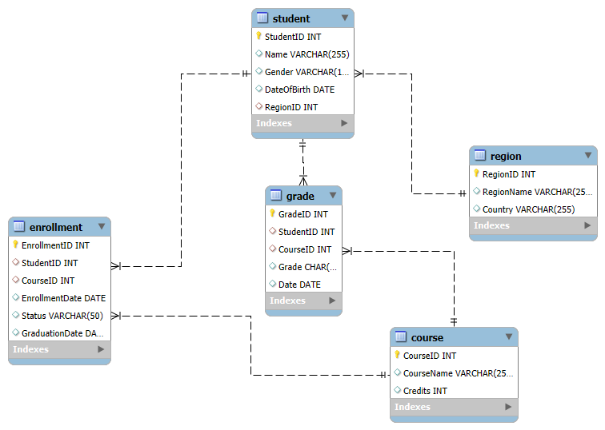
PRODUCT BENEFITS
This Entity-Relationship Diagram (ERD) illustrates the structure of the relational database designed to track and manage student enrollment and graduation data. Key tables include:
Students: Containing details about each student.
Courses: Listing the courses available for enrollment.
Enrollment: Connecting students with the courses they are enrolled in.
Grades: Storing the grades students receive in each course.
The relationships between these tables ensure that we can effectively track which students are enrolled in which courses, their grades, and their graduation status, providing the necessary data to analyze and improve education outcomes.
Simple and efficient to use
Quick customer service assistance
Free 90-day investment help for new customers
Benefits
3

Slide 4

Integration & Testing
Data Import from MySQL to Excel
Pivot Tables & Charts Creation
Exported student enrollment data from MySQL as a CSV file.
Imported the CSV file into Excel using Data > Get Data > From Text/CSV option.
Created Pivot Tables to summarize the enrollment data by course and year.
Designed visualizations:
Bar chart for enrollment by course.
Line chart for the trend over time.
Stacked column chart for enrollment by course and year.
Dashboard Integration & Interactivity
Linked Pivot Tables to charts for dynamic data display.
Added Slicers for easy filtering by year and course.
Enabled Dropdowns to allow selection of different courses and years.
Testing & Validation
Tested the dashboard by ensuring that slicers updated all charts correctly.
Verified that enrollment numbers match the data from MySQL queries.
Ensured consistency of data in all charts and pivot tables.

Slide 5

Data Analysis & Insights
Summary of Key Finding
The most popular courses are History and Literature , with Literature showing the highest enrollment.
Math and Science have lower but steady enrollments.
Key Insights from Data Analysis:
Enrollment Trends Over Time
The data reveals steady growth in student enrollment, with a significant increase in 2022.
Most Popular Courses
History and Literature courses have the highest enrollment numbers while Math and Science show consistent enrollment but at lower levels
Course Enrollment Distribution
History and Literature courses dominate with the highest enrollment numbers, followed by Math and Science .
5

Slide 6
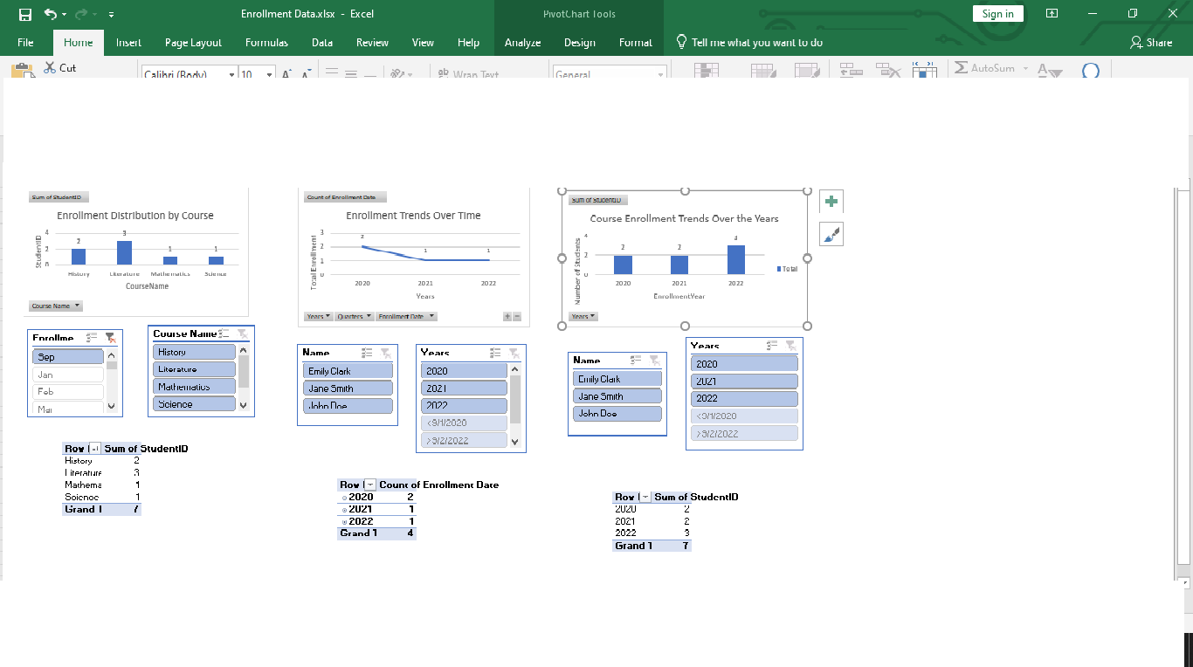
MARKET OVERVIEW
Excel Dashboard
$3B
$2B
$1B
Opportunity to build
Fully inclusive market
Total addressable market
Freedom to invent
Selectively inclusive market
Serviceable available market
Few competitors
Specifically targeted market
Serviceable obtainable market
6

Slide 7
Insights & Conclusion
Key Insights from the Project
Conclusions
The student enrollment trend steadily increased from 2020 to 2022, reflecting an overall growth in student engagement.
Literature and History courses saw the highest enrollment, demonstrating strong interest in humanities courses.
Math and Science courses, while important, had lower enrollment compared to the humanities.
The growing demand for Literature and History courses suggests that students may be gravitating toward humanities, possibly due to changing interests or societal factors.
The Math and Science fields, while still essential, may need additional outreach or curriculum changes to attract more students.
Final Thoughts
This project illustrates the power of data analysis and visualization to uncover trends and inform decisions in the education sector
7

Slide 8

Next Steps
Further Research
Data Enrichment
Investigate the reasons behind the increase in enrollment from 2020 to 2022.
Explore any socio-economic, cultural, or policy changes that might have influenced this trend.
Expand the dataset to include additional variables, such as student demographics (age, gender, region) to uncover deeper insights
Collect data on student academic performance to analyze correlations between enrollment and performance in different subjects.
Dashboard Enhancements
Actionable Insights
Add more interactive features to the dashboard, such as comparisons between enrollment by region, gender, or other factors.
Integrate predictive analytics to forecast future enrollment trends.
Collaborate with educational stakeholders to develop strategies for expanding popular courses and addressing the decline in enrollments in certain subjects.
Use the data-driven insights to guide decisions about curriculum development and resource allocation.
8

Slide 9

CONCLUSION
Summary of Findings
Impact of the Project
The student enrollment data revealed a steady increase in enrollment from 2020 to 2022, with Literature and History courses being the most popular.
Math and Science courses saw lower enrollments, which indicates an opportunity to revamp or promote these subjects more effectively.
The interactive Excel dashboard enabled detailed analysis of enrollment trends and provided key insights for stakeholders.
This project showcases the potential of data analysis to uncover valuable insights in education, guiding institutions in their decision-making processes.
The use of Excel for data analysis and visualization can significantly improve the way educational data is utilized for decision-making and policy formulation.
Final Thoughts
The insights gained from this project can help educational institutions plan and adjust their curricula based on evolving trends in student interest and enrollment.

Slide 10
REFERENCES
Educational Data
Data Analysis and Visualization:
Database Design
Microsoft. (2022). Microsoft Excel Data Analysis. Microsoft Documentation. Retrieved from https://support.microsoft.com/en-us/excel
United Nations. (2015). Transforming our world: The 2030 Agenda for Sustainable Development. United Nations. Retrieved from https://sdgs.un.org/2030agenda
Coronel, C., & Morris, S. (2015). Database Systems: Design, Implementation, & Management. Cengage Learning.
MySQL and ERD
Data Visualization Best Practices
Oracle. (2021). MySQL Documentation. Oracle. Retrieved from https://dev.mysql.com/doc/
Kirk, A. (2016). Data Visualization: A Handbook for Data Driven Design. Sage.

